Slide 1
Development of Methods for Retrieval and Interpretation of TEMPO NO₂ Columns for Top-down Constraints on NO_{x} Emissions & NO_{y} Deposition
Randall Martin (Dalhousie, Harvard-Smithsonian)
and
Jeff Geddes (Dalhousie → Boston University)
with contributions from
Matthew Cooper (Dalhousie), Daven Henze (CU Boulder)
TEMPO Science Team Meeting
Washington DC
2 June 2016

Slide 2
Major Challenges in the Retrieval and Interpretation of TEMPO NO₂ Columns to Understand NO_{x} Emissions
Separation of the stratospheric and tropospheric NO₂ columns (Geddes, McLinden)
Accounting for diurnally-varying air mass factor (Lamsal, Krotkov, Cohen)
Developing methods to relate NO₂ columns to NO_{x} emissions (Cohen & this talk)
Altitude
Concentration

Slide 3
Inversion Approaches for NO_{x} Emissions using a CTM
Trop NO₂ Column
Surface NO_{x} Emission

Slide 4
Inversion Approaches for NO_{x} Emissions using a CTM
Basic Mass Balance
  E_{t} ≡ top-down NO_{x} emission
  Ω_{r} ≡ retrieved NO₂ column
  α ≡ linear coefficient (s⁻¹)
Trop NO₂ Column
Surface NO_{x} Emission

Slide 5
Inversion Approaches for NO_{x} Emissions using a CTM
Basic Mass Balance
  E_{t} ≡ top-down NO_{x} emission
  Ω_{r} ≡ retrieved NO₂ column
  α ≡ linear coefficient (s⁻¹)
Finite Difference Mass Balance
used for timely updates (Lamsal et al., 2011):
E_{a} ≡ a priori NO_{x} emission
Ω_{a} ≡ a priori NO₂ column
(unitless)
Iterative Finite Difference Mass Balance
Adjoint Approach: formal inversion with linearization and iteration
Trop NO₂ Column
Surface NO_{x} Emission

Slide 6
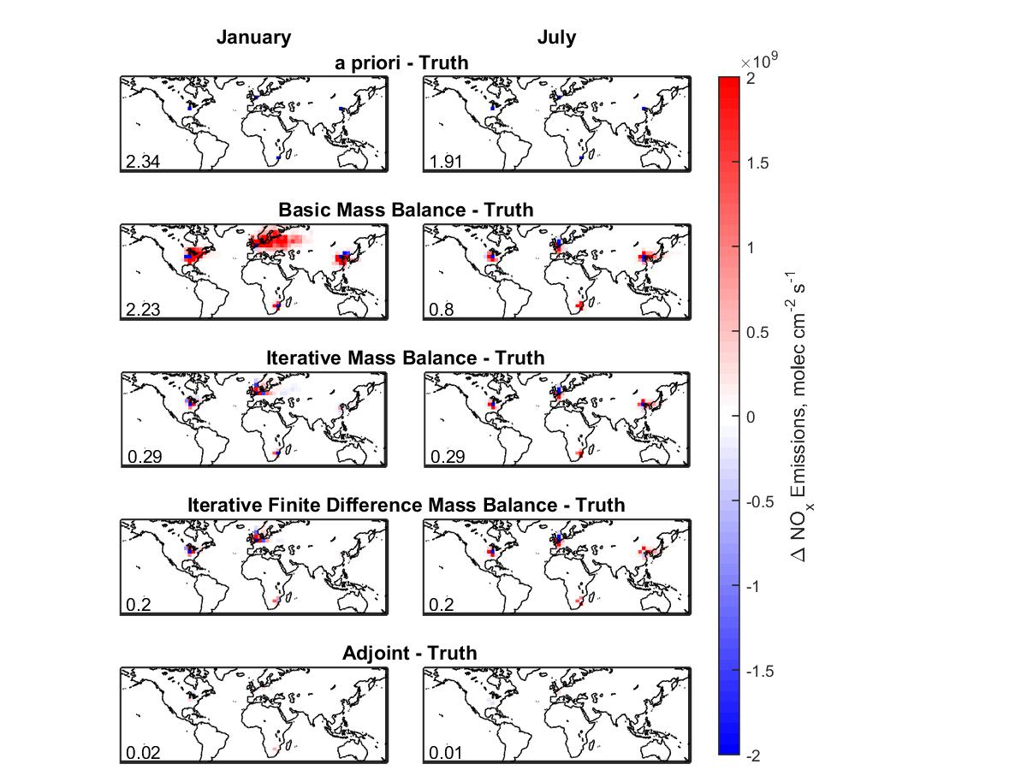
Adjoint Approach Eliminates Smearing for Idealized Scenario
Test to Recover Doubled NO_{x} Emissions in Four Locations Using a Week of Synthetic Observations of NO₂ Columns
January July
Inset Values are Normalized Mean Error
Cooper et al., in prep.

Slide 7
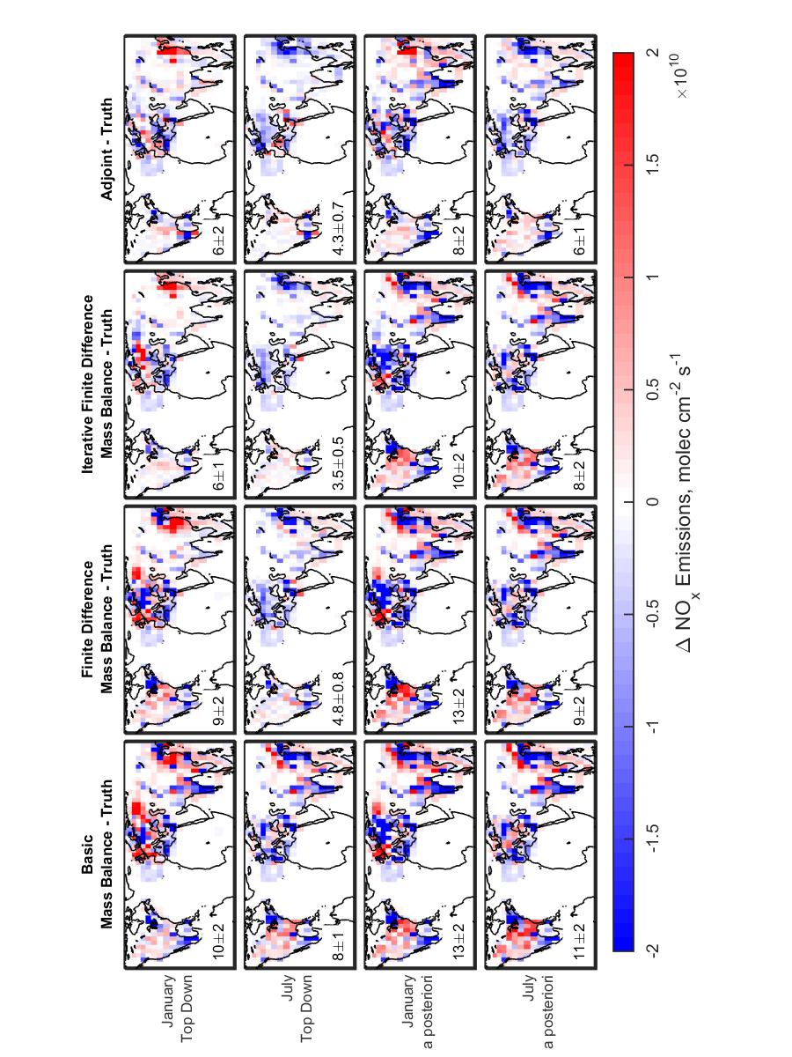
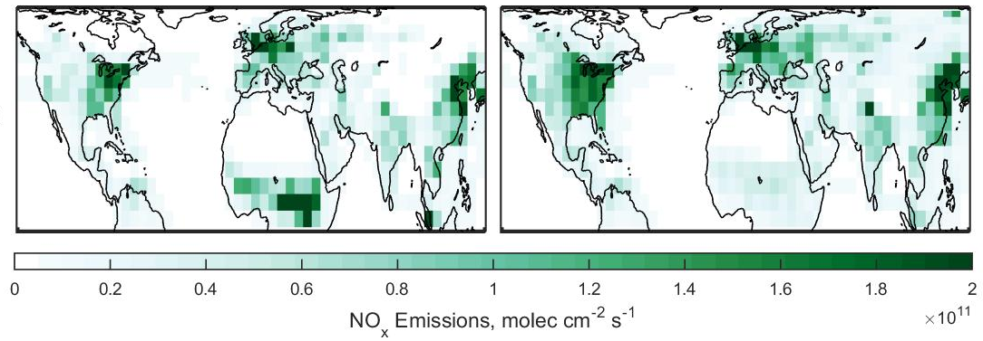
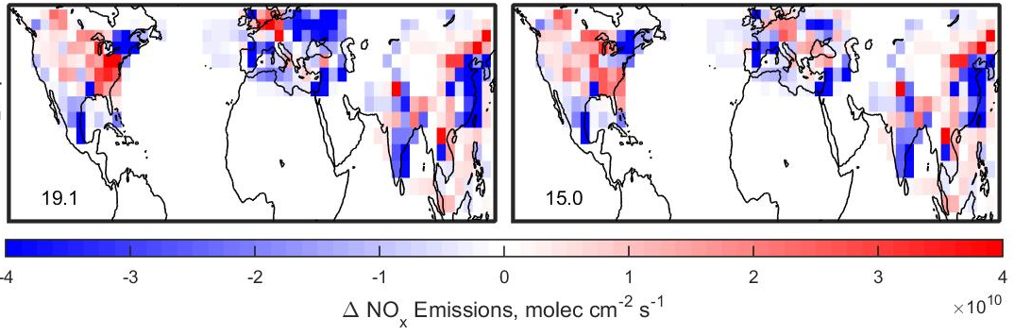
Similar Performance for Iterative Finite Difference Mass Balance and Adjoint Inversion Methods
Jan
July
A Priori A Priori – “Truth”
Jan
Jul
Jan
Jul
Inset Values are Normalized Mean Error
Cooper et al., in prep.

Slide 8
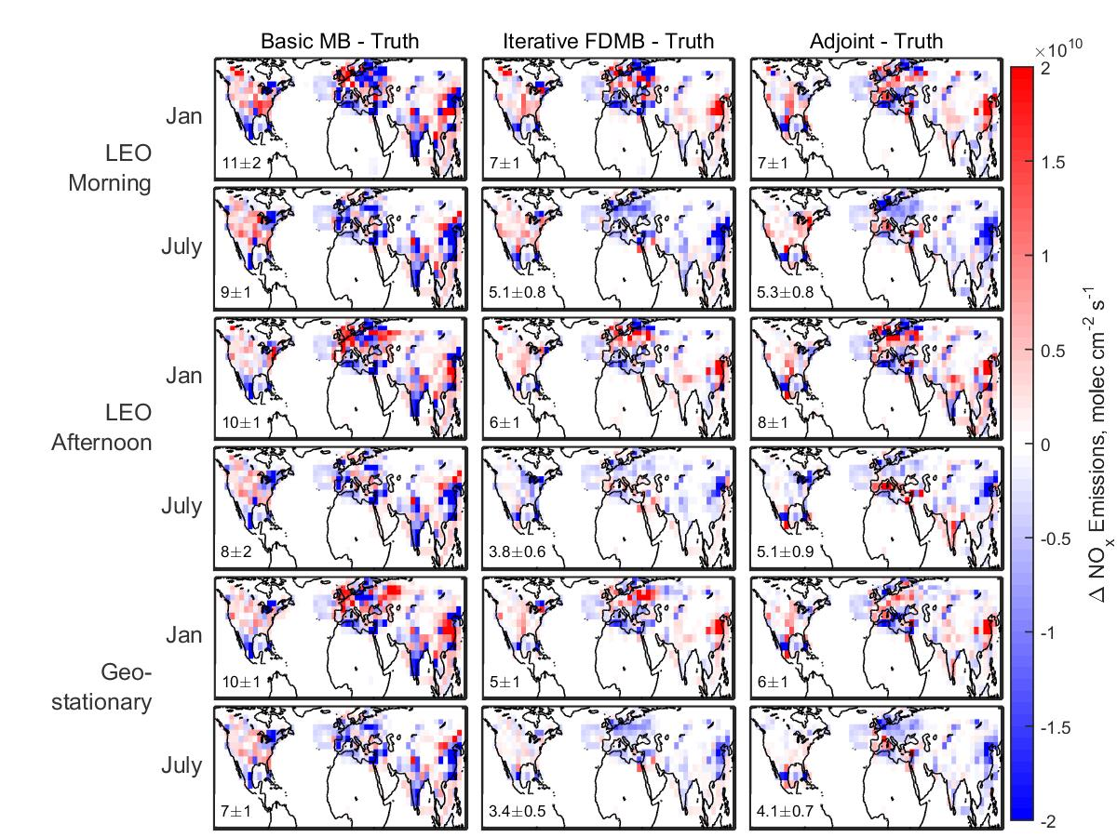
All Methods Benefit from Density of Geostationary Obs
Basic Mass Balance – “Truth”
Iterative Finite Difference Mass Balance – “Truth”
Adjoint Method – “Truth”
GEO
LEO
PM
LEO
AM
Inset Values are Normalized Mean Error
Tests shown for July
Cooper et al., in prep.

Slide 9
Iterative finite difference mass balance offers the potential for accurate and computationally efficient top-down emission constraints
Temporal Density of Geostationary Observations (i.e. TEMPO) Benefits Inversion for NO_{x} Emissions

Slide 10
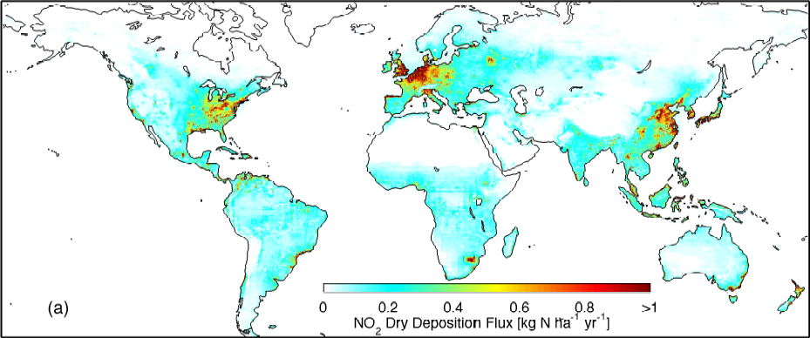
E.g. NO_{y} Deposition Updates
Previous Work:
Use OMI-derived surface NO₂ concentrations (combined with dry deposition paramaterization from GEOS-Chem) to estimate NO₂ dry deposition flux
Nowlan et al. 2014 (GBC)
Next development:
Update surface NO_{x} emissions “online” (cf. Lamsal et al. 2011) using finite difference mass balance
  satellite-NO₂ information is propagated to all NO_{y} species (and includes wet+dry deposition)

Slide 11
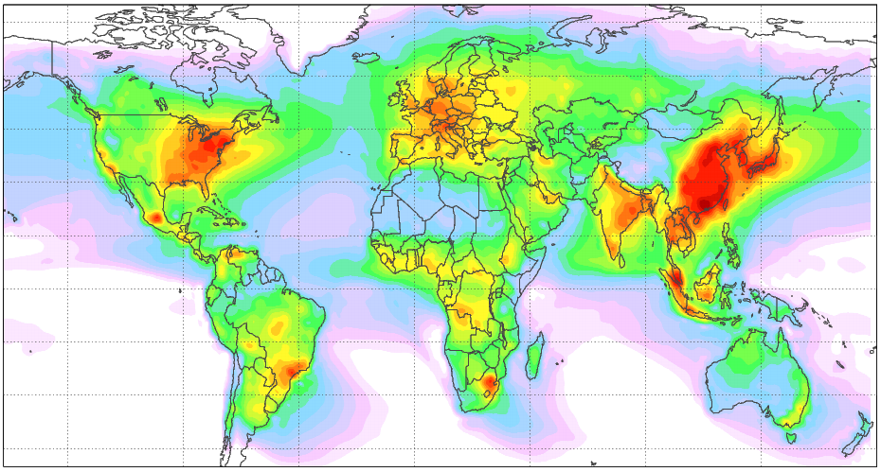
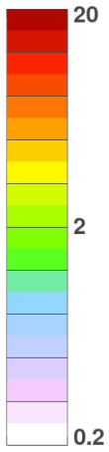
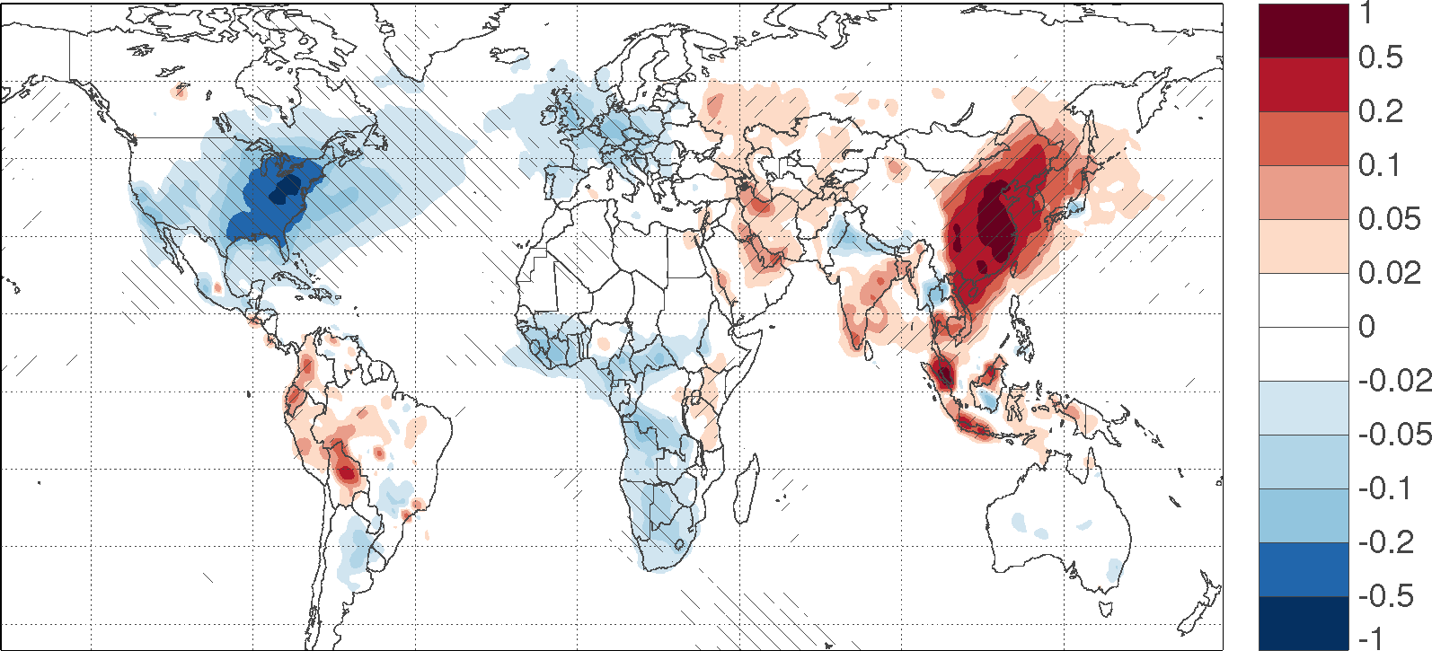
NO_{y} Deposition Derived from GOME/SCIAMACHY/GOME2
Long-term mean
(1996-2014)
kg N ha⁻¹ yr⁻¹
Long-term trend
kg N hr⁻¹ yr⁻¹
1996-2014
p < 0.01
Decreasing
Increasing
Geddes et al., in prep

Slide 12
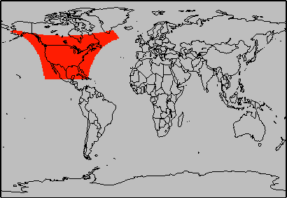
NO₂ Stratosphere-Troposphere Separation
Algorithms tend to rely on large coverage of observations where tropospheric signal is low
Will current algorithm work for stratosphere-troposphere separation from TEMPO?
Approach:
Reproduce Bucsela et al. (2013) algorithm using OMI observations
  *Use NO₂ observations from GOME-2 (or similar) for prior tropospheric NO₂ instead of a model
Repeat using OMI observations only within anticipated TEMPO field-of-regard (as surrogate for real TEMPO observations)

Slide 13
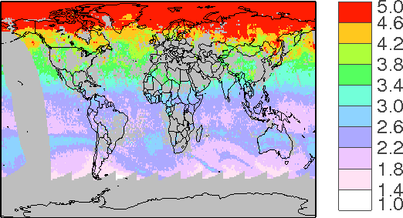
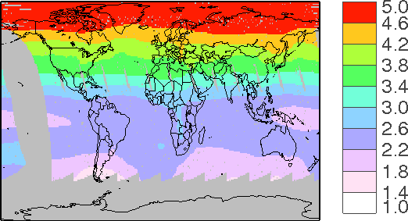
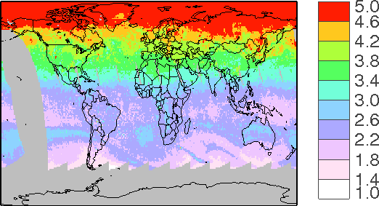
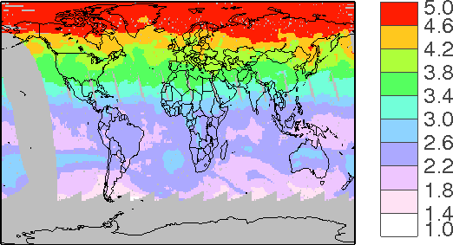
Current Operational Algorithm: Bucsela et al. 2013
Mask tropospheric contamination:
Smooth and interpolate:
10¹⁵ molecules cm⁻²
Replace masked areas:
Eliminate leftover hotspots:
10¹⁵ molecules cm⁻²

Slide 14
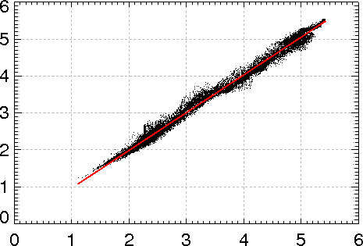
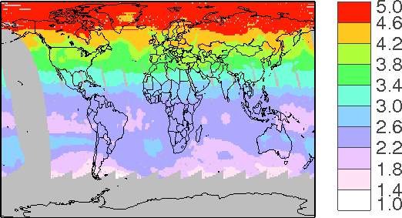
Current Operational Algorithm: Bucsela et al. 2013
July 7, 2007: Our stratospheric NO₂
r = 0.996
m = 1.023 (RMA)
10¹⁵ molecules cm⁻²
Our stratospheric NO₂
July 7, 2007: OMI stratospheric NO₂
10¹⁵ molecules cm⁻²
OMI stratospheric NO₂
Ignoring certain subtleties in Bucsela algorithm:
Different prior tropospheric NO₂
Invariant averaging window
10¹⁵ molecules cm⁻²

Slide 15
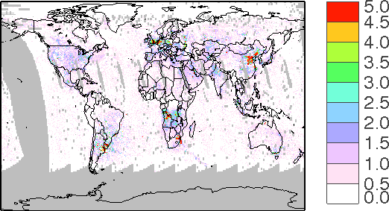
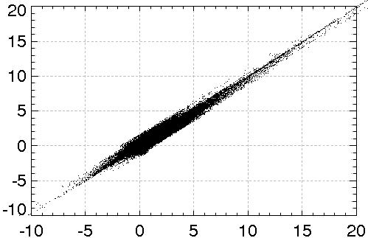
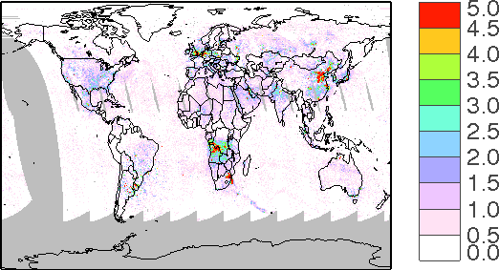
Current Operational Algorithm: Bucsela et al. 2013
July 7, 2007: Our tropospheric NO₂
r = 0.961
m = 0.975 (RMA)
10¹⁵ molecules cm⁻²
Our tropospheric NO₂
July 7, 2007: OMI stratospheric NO₂
10¹⁵ molecules cm⁻²
OMI tropospheric NO₂
10¹⁵ molecules cm⁻²

Slide 16
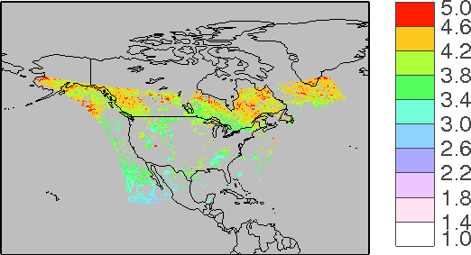
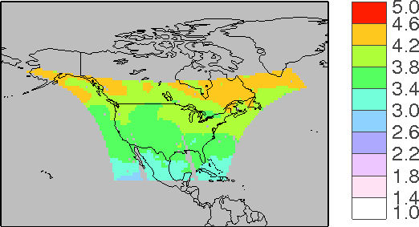
Test for TEMPO Field of Regard
10¹⁵ molecules cm⁻²
10¹⁵ molecules cm⁻²

Slide 17
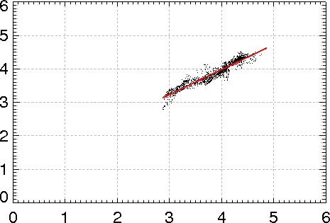
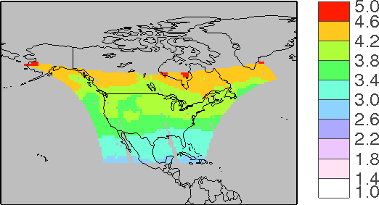
July Results: Stratosphere NO₂
July 7, 2007: Our stratospheric NO₂
r = 0.953
m = 0.783 (RMA)
NMB < 1%
10¹⁵ molecules cm⁻²
Our stratospheric NO₂
July 7, 2007: OMI stratospheric NO₂
10¹⁵ molecules cm⁻²
OMI stratospheric NO₂
Using only TEMPO field of regard, observations are still well correlated, but introduces some bias (especially at lower values) compared to global algorithm
10¹⁵ molecules cm⁻²

Slide 18
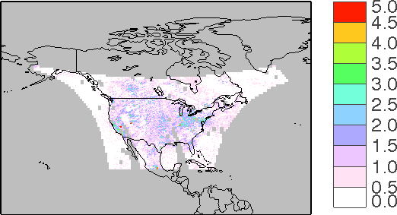
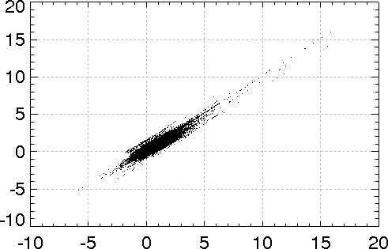
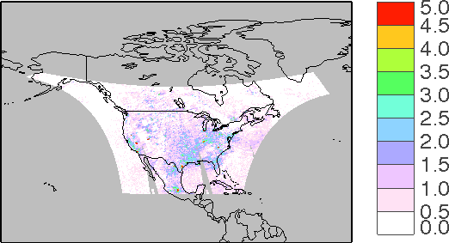
July Troposphere NO₂: Highly Consistent Results
July 7, 2007: Our tropospheric NO₂
r = 0.915
m = 0.971 (RMA)
NMB = -3%
10¹⁵ molecules cm⁻²
Our tropospheric NO₂
July 7, 2007: OMI tropospheric NO₂
10¹⁵ molecules cm⁻²
OMI tropospheric NO₂
10¹⁵ molecules cm⁻²

Slide 19
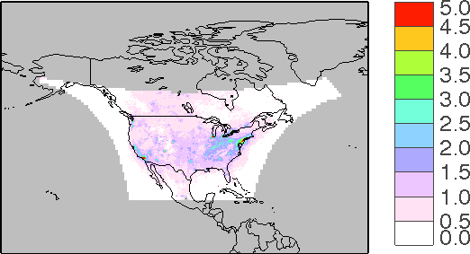
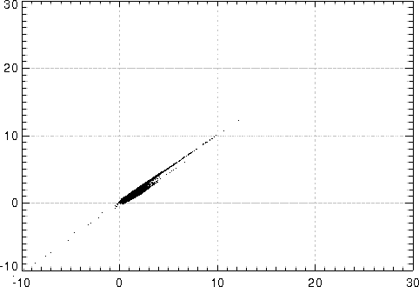
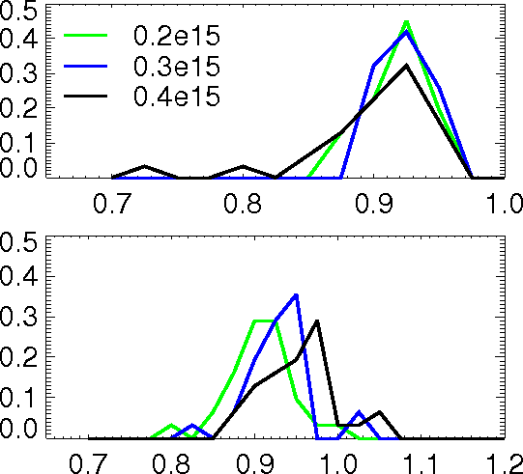
July Monthly Mean: Highly Consistent Results
r = 0.91
m = 0.91 (RMA)
10¹⁵ molecules cm⁻²
Our tropospheric NO₂
10¹⁵ molecules cm⁻²
Correlation
Coefficient
OMI tropospheric NO₂
Effect of being more strict in terms of tropospheric contamination:
Frequency
RMA Slope

Slide 20
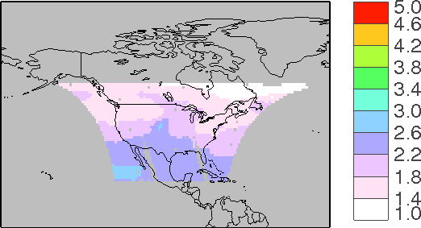
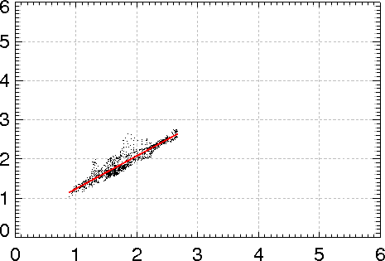
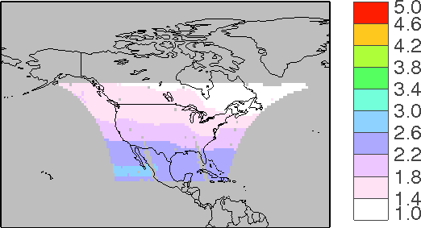
January Results
January 7, 2007: Our stratospheric NO₂
r = 0.900
m = 0.895 (RMA)
10¹⁵ molecules cm⁻²
Our stratospheric NO₂
January 7, 2007: OMI stratospheric NO₂
10¹⁵ molecules cm⁻²
OMI stratospheric NO₂
10¹⁵ molecules cm⁻²

Slide 21
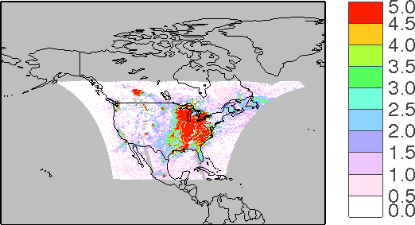
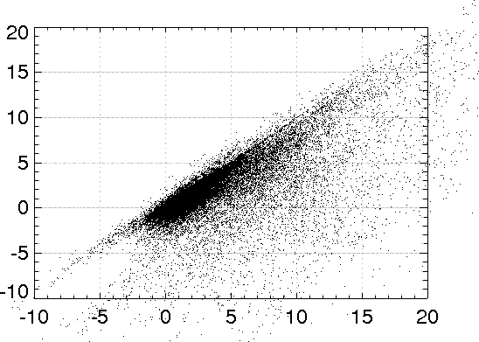
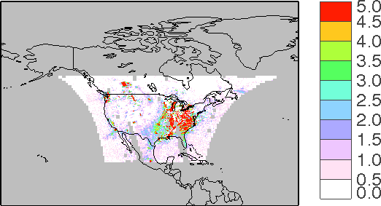
January Results
January 7, 2007: Our tropospheric NO₂
r = 0.79
m = 0.76 (RMA)
10¹⁵ molecules cm⁻²
Our tropospheric NO₂
January 7, 2007: OMI tropospheric NO₂
10¹⁵ molecules cm⁻²
OMI tropospheric NO₂
10¹⁵ molecules cm⁻²

Slide 22
Importance of AMF
Actual calculation:
Can show:
Means that small differences in stratospheric estimates can be magnified many times

Slide 23
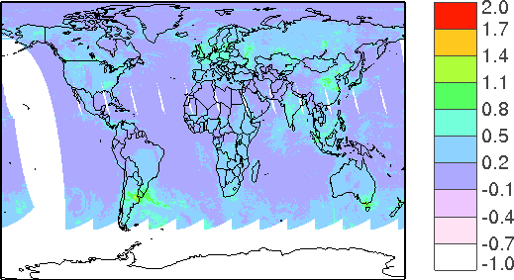
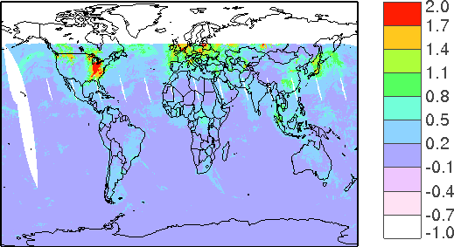
High AMF_{strat} / AMF_{trop} Ratio in Winter
Produces Large Uncertainty in Troposphere
JULY
JANUARY
log10( AMFstrat / AMFtrop)
Ratio on order of 1-3
Ratio exceeds 100

Slide 24
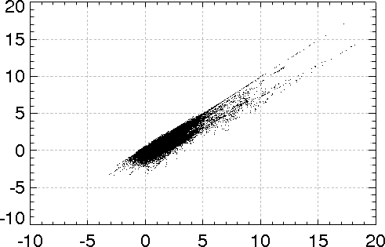
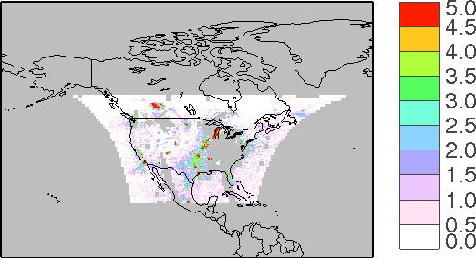
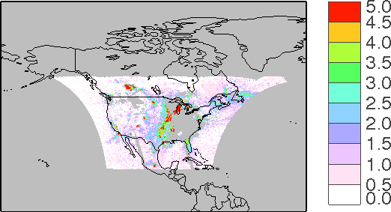
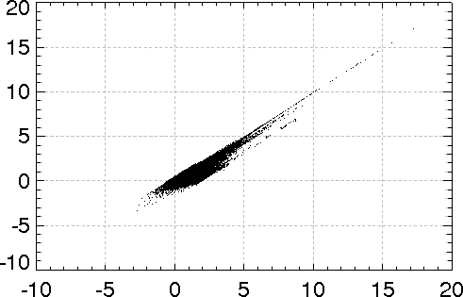
January Results: AMF_{trop} > 0.5
January 7, 2007: Our tropospheric NO₂
r = 0.889
m = 0.888 (RMA)
Our tropospheric NO₂
10¹⁵ molecules cm⁻²
10¹⁵ molecules cm⁻²
OMI tropospheric NO₂
January 7, 2007: OMI tropospheric NO₂
AMF_{strat}/AMF_{trop} < 5
r = 0.903
m = 0.930 (RMA)
Our tropospheric NO₂
10¹⁵ molecules cm⁻²
10¹⁵ molecules cm⁻²
OMI tropospheric NO₂

Slide 25
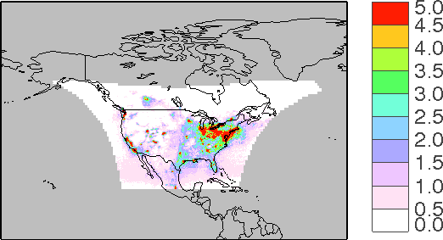
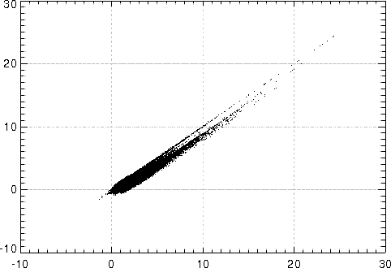
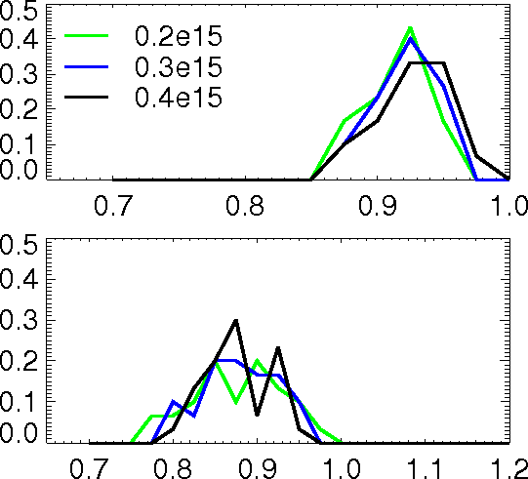
January Mean: AMF Filter Produces Consistent Results
r = 0.95
m = 0.87 (RMA)
10¹⁵ molecules cm⁻²
Our tropospheric NO₂
10¹⁵ molecules cm⁻²
Correlation
Coefficient
OMI tropospheric NO₂
Effect of being more strict in terms of tropospheric contamination:
Frequency
RMA Slope

Slide 26
Summary
Suitable stratosphere-troposphere separation achievable within TEMPO field of regard using current OMI algorithm
High stratospheric AMFs / low tropospheric AMFs in wintertime introduce large uncertainty in derived product especially during winter
Fine-tuning (different thresholds, size of averaging windows, including information from LEO observations at boundaries) could be explored to improve performance
Easily applicable to other times of day with good correlation: good indication for TEMPO

